Slide 1

Project Management and Entrepreneurship KHU702
DEPARTMENT OF IT

Slide 2
Project Cost Estimation
What is a cost estimate?
Project cost estimation is the process of predicting the quantity, cost, and price of the resources required by the scope of a project.
Since cost estimation is about the prediction of costs rather than counting the actual cost, a certain degree of uncertainty is involved. This uncertainty arises from the fact that the project scope definition is never entirely complete until the project has been finished, at which point all expenses have been made and an accountant can determine the exact amount of money spent on resources.
Cost estimation, therefore, is like ‘looking into a crystal ball’.

Slide 3
Why project cost estimation?
Different reasons:
- Investment decisions,
- Comparing alternative plans,
- Budgeting,
- Cost control, and validation.
Cost estimates are prepared to different ends throughout the project lifecycle. Upfront, the goal is to provide input for investment decisions. The cost estimate is used to determine the size of the required investment to create or modify assets. It is also during the early phases that alternative plans are considered that need to be priced. The cost estimate is a deliverable that serves the decision-making process at each gate of the project lifecycle

Slide 4
Why project cost estimation is important??
There are many reasons why cost estimation is an indispensable part of project management.
A cost estimate reflects if the project is financially viable. First things first, an accurate cost estimate is essential for deciding if the project is feasible or not for the company at the moment. In this light, a cost estimate answers if the project can be completed with available resources in the given time period and still bring value to the organization.
Cost estimation helps to stay on schedule and on track. At the end of the day, sound project estimates are important to ensure that actual effort, once the project is in progress, matches the estimated targets that were set at the beginning of the project to the greatest possible extent. Thus estimates are one of the foundational pillars for safeguarding client expectations and your company’s bottom line.

Slide 5
Common project cost estimation techniques
Depending on your project type and size, stakeholder expectations, potential billing method, and other project-related factors, various techniques and tools can be applied to make an educated guess about the project’s price. We’ve gathered them in one table together with recommendations.
Estimation Bottom-up estimation | Definition Assigning costs to the individual elements of the project plan, such as tasks, milestones, or phases, and putting the bucks together | Requirements Best for estimating projects with defined expectations and specific requirements in line with stakeholders who won’t expect major changes in the scope

Slide 6
Common project cost estimation techniques
Estimation Top-down estimation Analogous estimation Parametric estimation Three-point estimation | Definition Figuring out the project’s total price and determining the scope of work that can be done. Relying on data from previous similar projects to forecast the cost. Taking specific cost variables and data points from other projects to figure out the ultimate project cost. Doing the average from the best, worst, and most likely case estimations | Requirements Commonly used to estimate elements on fixed price projects when the price is initially specified by the client Recommended when there’s limited information about the project. Usually called in for use when the previous project data you have is scalable Well-advised when the risk of going over budget is high

Slide 7
Prime reasons for inaccurate project cost estimates
More often than not, project cost estimates turn out to be off-the-mark. The main reason being the timing when they’re made - during the proposal phase - that is when you know the least about the project, plus many other factors that compromise the quality of cost estimates. The common pitfalls to watch out for that can destroy the accuracy and reliability of your estimates are:
Long Sighted predictions. Seasoned project managers know that every estimate is a premature estimate if it’s made a long time in advance, let’s say to predict the budget three years ahead. It immediately turns into a guess estimate that will hardly be relevant then.
Shortage of expertise on similar projects. There is no denial of the fact that better cost estimates come with experience on comparable initiatives. Analogous projects inform your next estimation decisions by giving you a clearer understanding of how the new project can be better scoped out and which milestones take longer than usual.
Lack of requirements. Having an idea what the project is all about is not enough. To provide an accurate estimate, every element in the project should be specified per client’s request. Staying on the same page with the client will help you break the project down into manageable chunks of work and ensure that you don't miss out on anyone’s expectations.

Slide 8
Prime reasons for inaccurate project cost estimates
Splitting one task across multiple resources. When more than one person works on a task, clear processes should be set in place, which in turn requires additional planning and management time, often not taken into account. Not only does it make the task last longer, but it also increases chances of overshot deadlines and estimates. In the end, one task divided between multiple team members turns out to be more costly than you initially thought.
Expecting that resources will work at full battery. Total efficiency at workplace is a utopia we all want to believe in. There will always be “dead time” or unexpected non-billable work. A more reasonable number to target would be 70-80%. Don’t forget to include that when scoping your next project.

Slide 9
The pros of using a spreadsheet for cost estimation
Almost an industry standard
Low barrier for entry (Most people have access to it and know how to use it)
Very adaptable and customizable
Easy to analyze, present, and pivot data (for a single project at least)
Easy to copy and distribute

Slide 10
The cons of using a spreadsheet for cost estimation
Very adaptable and customizable
Error-prone due to its manual nature
Only accessible locally and not by multiple people at the same time
Easy to copy and distribute (How do you easily merge input from 10 people?)
Almost impossible to consolidate input of data due to its delicate nature
No easy way to learn from previous projects and take advantage of historic data
Rubbish at comparing projects and their data without substantial manual effort
No version control (Which always results in substantial rework)
Very hard to track Key Performance Indicators (KPIs) in a timely manner to react to them

Slide 11
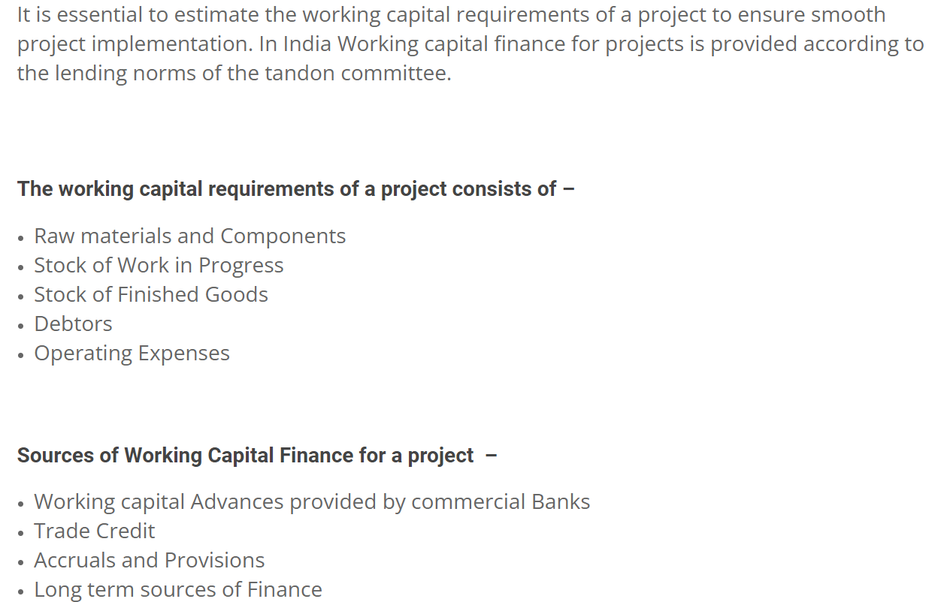
Working Capital Requirements of a Project

Slide 12
Estimation of Working Capital Requirements
In estimating working capital needs, different people adopt different approaches. Some experts suggest that the working capital should be greater than the minimum requirements of the firm. The management should feel safety. It would be able to meet its obligations even in adverse circumstances. However, the excessive capital may lead to waste and inefficiency. On the other hand, some experts suggest that the working capital should be lower than the requirement so that no idle funds shall be invested in the current assets and it ultimately leads to increase in profitability of the company.
There are various approaches which have been applied in practice for the estimation of working capital requirements.
1. Conservative Approach
The conservative approach states that the proportion of current assets to current liabilities should be kept at 2:1. Is this proportion is to be kept the firm would be able to meet its obligations on time and hence its financial solvency would not be in trouble.
However, the limitation of this approach is that it suggests only quantitative measure. It does not suggest as to what type of assets are to be included in current assets. If the current assets contain stock, which is outdated or receivable which are not collectable, than the amount of current assets has no meaning.

Slide 13
Estimation of Working Capital Requirements
2. Components Approach
Here we take up one of the planning models of working capital to estimate working capital. The method adopted here attempts at estimation of working capital and its components by taking into account, the period for which the various items remain as stock or as outstanding, the cost structure of production and annual production.
3. Operating Cycle Approach
It was earlier referred to that working capital is also known as revolving capital. That is, a circular path of conversion/re-conversion takes place.

Slide 14
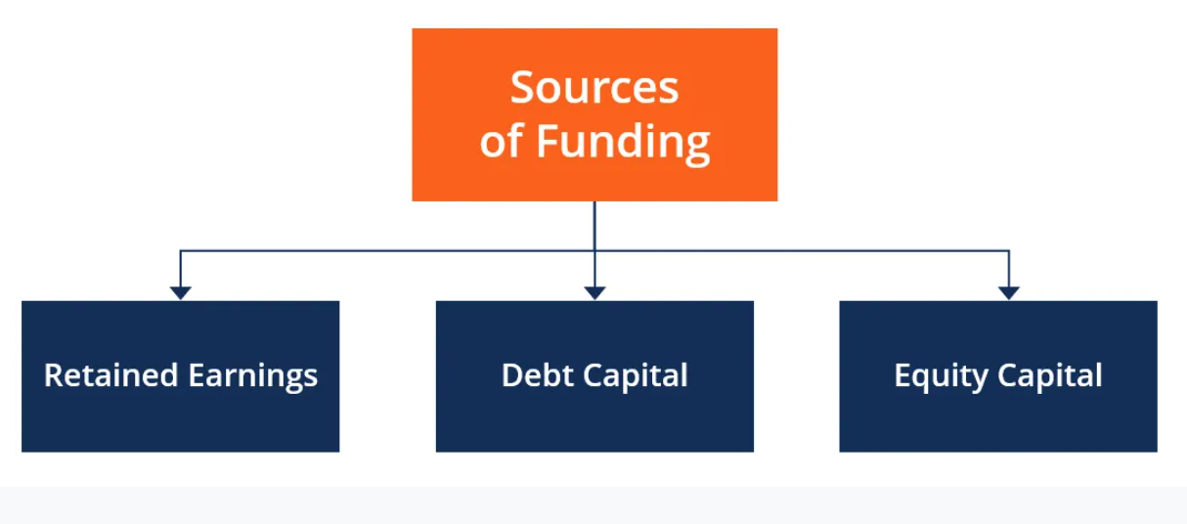
What are Sources of Funding?
Companies always seek sources of funding to grow the business. Funding, also called financing, represents an act of contributing resources to finance a program, project, or a need. Funding can be initiated for either short-term or long-term purposes. The different sources of funding include:
Retained earnings
Debt capital
Equity capital

Slide 15
What are Sources of Funding?
Retained Earnings
Businesses aim to maximize profits by selling a product or rendering service for a price higher than what it costs them to produce the goods. It is the most primitive source of funding for any company.
After generating profits, a company decides what to do with the earned capital and how to allocate it efficiently. The retained earnings can be distributed to shareholders as dividends, or the company can reduce the number of shares outstanding by initiating a stock repurchase campaign.
Alternatively, the company can invest the money into a new project, say, building a new factory, or partnering with other companies to create a joint venture

Slide 16
What are Sources of Funding?
Debt Capital
Companies obtain debt financing privately through bank loans. They can also source new funds by issuing debt to the public.
In debt financing, the issuer (borrower) issues debt securities, such as corporate bonds or promissory notes. Debt issues also include debentures, leases.
Companies that initiate debt issues are borrowers because they exchange securities for cash needed to perform certain activities. The companies will be then repaying the debt (principal and interest) according to the specified debt repayment schedule and contracts underlying the issued debt securities.
The drawback of borrowing money through debt is that borrowers need to make interest payments, as well as principal repayments, on time. Failure to do so may lead the borrower to default or bankruptcy.

Slide 17
What are Sources of Funding?
Equity Capital
Companies can raise funds from the public in exchange for a proportionate ownership stake in the company in the form of shares issued to investors who become shareholders after purchasing the shares.
Alternatively, private equity financing can be an option, provided there are entities or individuals in the company’s or directors’ network ready to invest in a project or wherever the money is needed for.
Compared to debt capital funding, equity funding does not require making interest payments to a borrower.
However, one disadvantage of equity capital funding is sharing profits among all shareholders in the long term. More importantly, shareholders dilute a company’s ownership control as long as it sells more shares.

Slide 18
What are Sources of Funding?
Other Funding Sources
Funding sources also include private equity, venture capital, donations, grants, and subsidies that do not have a direct requirement for return on investment (ROI), except for private equity and venture capital. They are also called “crowd funding” or “soft funding.”
Crowd funding represents a process of raising funds to fulfill a certain project or undertake a venture by obtaining small amounts of money from a large number of individuals. The crowd funding process usually takes place online.

Slide 19
What Is Capital Budgeting?
Capital budgeting involves choosing projects that add value to a company. The capital budgeting process can involve almost anything including acquiring land or purchasing fixed assets like a new truck or machinery.
Corporations are typically required, or at least recommended, to undertake those projects that will increase profitability and thus enhance shareholders' wealth.
However, the rate of return deemed acceptable or unacceptable is influenced by other factors specific to the company as well as the project.
For example, a social or charitable project is often not approved based on the rate of return, but more on the desire of a business to foster goodwill and contribute back to its community.

Slide 20
What Is Capital Budgeting?
KEY TAKEAWAYS
Capital budgeting is the process by which investors determine the value of a potential investment project.
The three most common approaches to project selection are payback period (PB), internal rate of return (IRR), and net present value (NPV).
The payback period determines how long it would take a company to see enough in cash flows to recover the original investment.
The internal rate of return is the expected return on a project—if the rate is higher than the cost of capital, it's a good project.
The net present value shows how profitable a project will be versus alternatives and is perhaps the most effective of the three methods.
.

Slide 21
Major Methods
Many formal methods are used in capital budgeting, including the techniques as followed:
Net present value
Internal rate of return
Payback period
Profitability index
Equivalent annuity
Real options analysis

Slide 22
Major Methods
Net Present Value
Net present value (NPV) is used to estimate each potential project’s value by using a discounted cash flow (DCF) valuation. This valuation requires estimating the size and timing of all the incremental cash flows from the project. The NPV is greatly affected by the discount rate, so selecting the proper rate sometimes called the hurdle rate–is critical to making the right decision.

